Slide 1

Operating System: Managing CPU, Memory & I/O
Technical Presentation
CSA04 - Operating Systems
Presented by
Name: ARTHI A
Register No.: 192525152
Course: CSA0416
Date: 10.08.2026

Slide 2
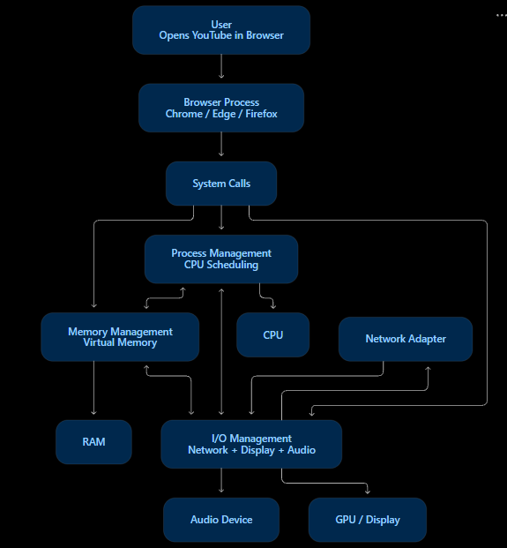
OS Architecture

Slide 3
Process Management
What does it do?
Creates and terminates processes.
Allocates CPU time.
Performs context switching.
Handles process synchronization.
Example System Calls
fork() → Create process
execve() → Run program
waitpid() → Wait for process
Example:
When Chrome starts, the OS creates and schedules its processes.

Slide 4
Memory Management
What does it do?
Allocates memory to processes.
Provides virtual memory.
Protects process memory.
Handles paging and page faults.
Example System Calls
mmap() → Map memory
munmap() → Release mapping
mprotect() → Change protection
Example:
A browser gets memory for webpages, tabs, and video buffers.

Slide 5
I/O Management
Example System Calls
open() → Open file/device
read() → Read data
write() → Write data
close() → Close resource
Example:
Reading a video file from an SSD requires OS I/O management.
What does it do?
Controls input/output devices.
Manages device drivers.
Handles buffering and caching.
Provides a common interface to devices.

Slide 6
Interaction Between OS Components
Example
A process requests data:
Process → read() → Kernel → Driver → Disk → RAM → Process
Key point:
OS components work together rather than independently.
Process
↓
CPU Scheduling
↓
Memory Management
↓
I/O Request
↓
Device Driver
↓
Hardware

Slide 7
Real-Time Example: YouTube
1. Process Management
Browser process receives CPU time.
2. Memory Management
Video data is stored in memory buffers.
3. I/O Management
Network receives video data.
4. Device Management
Video → GPU → Display
Audio → Sound Device
Example System Calls
socket() → Network connection
recv() → Receive data
mmap() → Memory mapping
Result: Smooth video playback through coordinated OS resource management.

Slide 8
Conclusion
Key Takeaways
Process Management → Manages CPU and processes.
Memory Management → Manages and protects memory.
I/O Management → Controls hardware communication.
System Calls → Interface between applications and kernel.
All components work together for efficient and secure execution.
Final Statement
The OS converts hardware resources into reliable services for applications.

